Slide 1
Lecture 3: BA at the Functional Level
Prof. Mike Boyle
Department of Operations and Information Systems
University of Utah

Slide 2
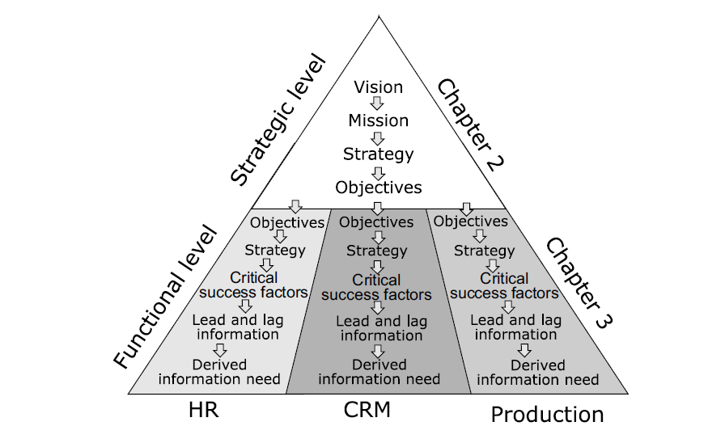
BA at the Functional Level
Discussion: Note the difference in the order of “Strategy” and “Objectives” at the Strategic Level vs. the Functional Level
This reflects the process of setting the direction and plan for execution for the organization

Slide 3
Example: A Trip to the Summerhouse
Topics to cover:
KPIs (Strategic and Functional)
Corporate/Business Performance Management (CPM/BMP)
Dashboards
Data and other requirements
Lead Information
Lag Information

Slide 4
Example: A Trip to the Summerhouse (cont’d)
Process Description:
60 mile trip
60 minutes (expected)
Operations:
Execute and monitor an instance of the process. Components of monitoring a process:
Status: what has been accomplished relative to plan
Answers: Where are we in the process?
Trend: speeding up/slowing down
Answers: What is our recent rate or progress/throughput/productivity?
Projection: will we arrive before/after target time
Answers: Are we going to going to hit our target for the process?

Slide 5
Example: A Trip to the Summerhouse (cont’d)
Strategic Level Objective: Reach the summerhouse in 60 minutes or less
E.g. KPI: % of times you reach the summerhouse in 60 minutes or less
Note: KPI objective is to measure several instances of the process
Functional Level Objective:
E.g. KPI: Actual miles/Budgeted miles (i.e. are you tracking during your trip?)
Note: KPI focused on single instance of the process
Discussion: What are some differences between the Strategic Level KPI compared to the Functional Level KPI?

Slide 6
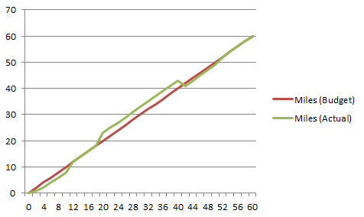


Example: A Trip to the Summerhouse (cont’d)
Define Performance Management Dashboard visually
Miles
Status:
KPI = 1
Trend:
KPI > 1
KPI > 1
Projection:
KPI < 1
Time

Slide 7
Example: A Trip to the Summerhouse (cont’d)
Define Performance Management Dashboard Data Requirements
Minutes from Start | Actual Miles | Actual/Target Miles
0 | 0 | NA
1 | 2 | 2.0
…
10 | 9 | 0.9

Slide 8
Example: A Trip to the Summerhouse (cont’d)
Define Performance Management Dashboard Other Requirements
Discussion: What other requirements should be articulated for the Performance Management Dashboard?
E.g.:
Frequency of updates
Alert thresholds
Alert distribution roles and individuals
Dashboard access for roles and individuals
Basic interactions (e.g. drill-down, filter, etc.)
(other)

Slide 9
Example: A Trip to the Summerhouse (cont’d)
Operations: Execute and monitor performance
Miles
Status:
KPI = 1
Trend:
KPI > 1
KPI > 1
Projection:
KPI < 1
Time

Slide 10
Example: A Trip to the Summerhouse (cont’d)
Operations: @ point A
Miles
Status:
KPI = 1
Trend:
KPI > 1
KPI > 1
Projection:
KPI < 1
Time

Slide 11
Example: A Trip to the Summerhouse (cont’d)
Operations: @ point B
Miles
Status:
KPI = 1
Trend:
KPI > 1
KPI > 1
Projection:
KPI < 1
Time

Slide 12
Example: A Trip to the Summerhouse (cont’d)
Operations: @ point C
Miles
Status:
KPI = 1
Trend:
KPI > 1
KPI > 1
Projection:
KPI < 1
Time

Slide 13
Example: A Trip to the Summerhouse (cont’d)
Discussion: What is the Lag Information in this case?
E.g.: Progress entries each minute during the trip
Discussion: What is some potential Lead Information in this case?
E.g.: Using a predictive model fit with historical trip data to predict an estimated time of arrival for the current trip
Notes:
Study about strengths and weaknesses of lead and lag information.

Slide 14
Example: A Trip to the Summerhouse (cont’d)
Consider Lag vs. Lead information @ point C:
What are the strengths and weaknesses of each approach?
Miles
Status:
KPI = 1
Trend:
KPI > 1
KPI > 1
Projection:
KPI < 1
Time

Slide 15

Example: A Trip to the Summerhouse (cont’d)
What does it indicate when KPIs are not being met?
Strategic focus issue (Strategy)
E.g. not enough focus on item
E.g. focusing on an inefficient item
Execution capability/resource issue (Functional)
E.g. ineffective project management/execution
E.g. insufficient technical skill/experience
Likely it is partly due to #1 and partly due to #2
E.g. In football, there is an ongoing argument: “Is it the play-calling or the execution?”
Answer: It depends who you ask and how they are incented

Slide 16
Example: A Trip to the Summerhouse (cont’d)
Discussion: What if you are taking the trip for the first time? Lead Information? Lag Information?
Discussion: What if you have taken the trip several times before, but there is a potentially better route?

Slide 17
Example: A Trip to the Summerhouse
(Summary) Topics to cover:
KPIs (Strategic and Functional)
Corporate/Business Performance Management (CPM/BMP)
Dashboards
Data and other requirements
Lead Information
Lag Information

Slide 18
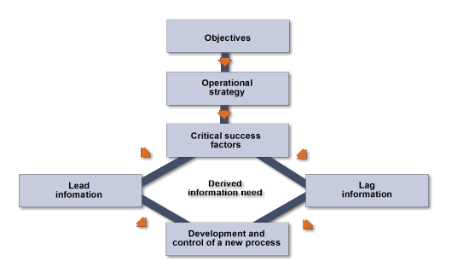
Establishing New Business Processes
Note the single direction starting from “Objectives” and the fork after “Critical Success Factors”

Slide 19
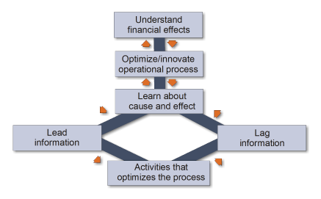
Optimizing Existing Processes
Note the cycle starting from “Understand financial effects”

Slide 20
New Processes vs. Optimization
Establish New Processes
Optimize Existing Processes

Slide 21
Example: Establishing New Business Process
Context:
Large telco
KPI 1: customer base 10% larger Y-O-Y
KPI 2: average revenue per customer 10% larger Y-O-Y
Marketing department (functional area)
Acquisition and Retention processes

Slide 22
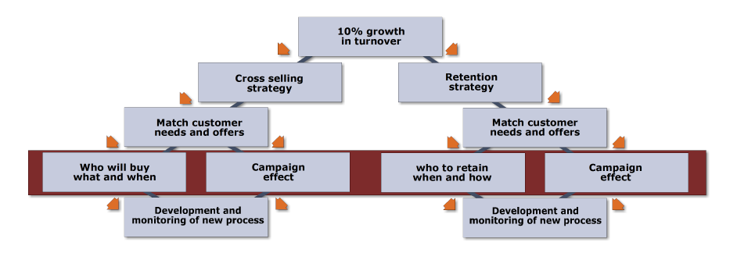
Example: Establishing New Business Process (cont’d)
Approach:
Add 10% more “Gold” customers
Covers KPI 1; gets us close to KPI 2 as the overall average revenue per customer increases (5%) by simply bringing on higher-quality customers
Market growth alone covers 3% of KPI 2
To make up the remainder of KPI 2 add a small amount of new sales (2%) to existing customers
Focus on “Information-based” CSFs

Slide 23
Example: Optimizing Existing Process
Background:
Recall: Two perspectives of efficiency gains to processes:
Use inputs more efficiently
Using the same level of inputs, improving the outputs
Context:
Large telco – mobile phone business unit
KPI 1: increase customer loyalty +X%
KPI 2: reduce call center costs by 10% without reducing quality
$400 to acquire a new customer
Call center is salary-heavy
Focus on Customer Service department (Functional area)

Slide 24
Example: Optimizing Existing Process
Approach:
Call Center
KPI 3: reduce repeat calls by 20%
Better CSR utilization (efficient use of inputs)
Higher customer satisfaction (improve outputs)
Lag to Lead information
Report 1: track issue types that lead to repeat calls (lag) and analyze for patterns (lead)
Report 2: track agents that have high repeat call rates (lag) and analyze for patterns (lead)
Corrective actions:
General subject training
Individual incentives
(Direction)

Slide 25
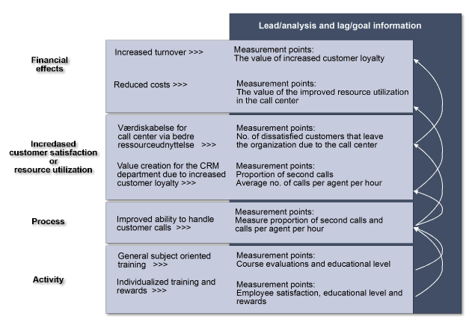
Example: Optimizing Existing Process
(Direction)

Slide 26
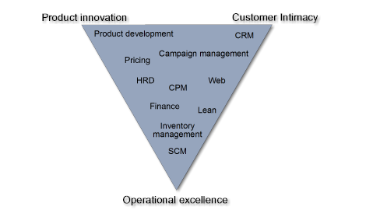
Prioritizing Processes to Apply BA
Recall: The Strategic Position of the Organization
Product Innovation
Customer Intimacy
Operational Excellence
E.g. If an organization has a strong Customer Intimacy position, then CRM BA projects should have a relatively high amount of resource allocation

Slide 27
Discussion: KPI by Function
Executive
Discuss
Sales and Marketing
Discuss
Human Resources
Discuss
Production
Discuss
IT
Discuss
Customer Service
Discuss
Finance
Discuss

Slide 28
Appendix

